Slide 1
DecLoco: A Decentralized Approach to Nature-Inspired Robot Locomotion
By Lorenzo G. Baracco

Slide 2
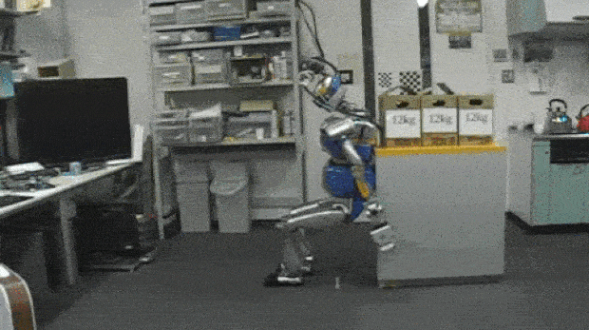
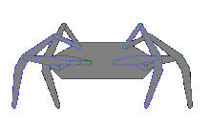
Domain: Robot Locomotion
Locomotion is an essential requirement for robot employed in a large number of tasks
Social robotics
Warehouse management
What approaches exist to tackle this problem?
Reinforcement Learning
Central Pattern Generators
UNIVERSITY OF TOKYO/JSK LABORATORY
Wikipedia: Klann linkage walking motion

Slide 3
Approaches overview
(Deep) Reinforcement Learning [1]
Robots are rewarded for each efficient and stable actions
At each control step, the most rewarding action is performed
Large neural network topologies are often needed
Scales extremely well
Currently the most popular method
Central Pattern Generators [2]
Imitation of animal locomotion Mechanisms
Linear input is turned into rhythmic output
Different mathematical tools
Numerical Integration
Fourier Series
Smaller parameter-space
Quicker optimization
[1] Haarnoja, T., Ha, S., Zhou, A., Tan, J., Tucker, G., Levine, S.: Learning to walk via deep reinforcement learning. arXiv preprint arXiv:1812.11103 (2018)
[2] Dzeladini, F., Ait-Bouziad, N., Ijspeert, A.: Cpg-based control of humanoid robot locomotion. Humanoid Robotics: A Reference pp. 1–35 (2018)

Slide 4
What problem is commonly overlooked?

Slide 5
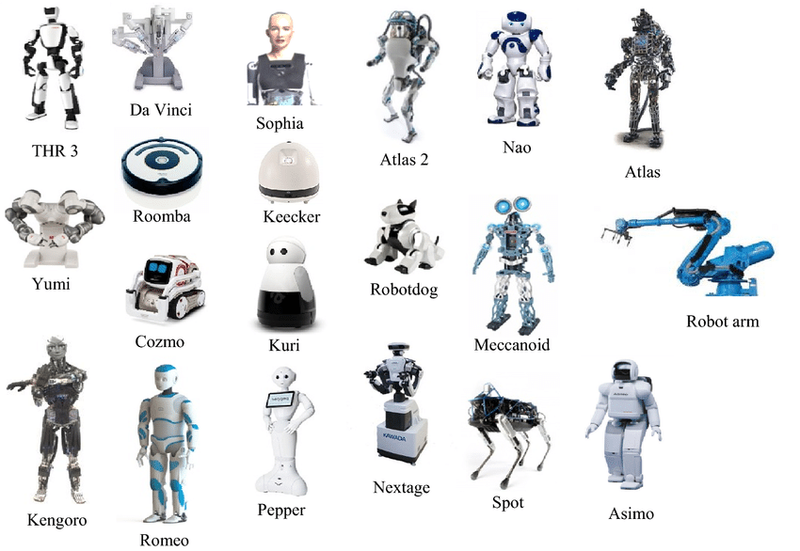
Problem Statement: Generalization
Many different robots with many different body shapes exist
Biped, quadruped, Wheeled
Different sizes and weights
Most approaches are centralized, optimizing
the movement of a single type of robot
Output
Actuators
Perception and Evaluation in Human–Robot Interaction: The Human–Robot Interaction Evaluation Scale (HRIES)—A Multicomponent Approach of Anthropomorphism
Input
State

Slide 6
Can we build a decentralized controller using some of the principles of CPGs?

Slide 7
Methods
Optimization: PGPE
Topology: Structured Control Network with Fourier Series
Architecture: Single-joint controller with state information of n neighbors
Objective: distance with minimal and symmetric movement

Slide 8
Methods: Optimization
PGPE [3]
Generate a population: established a center point x, perform gaussian perturbations over the parameters of x to create a new solution. Repeat n times
[3] Sehnke, F., Osendorfer, C., R ̈uckstieß, T., Graves, A., Peters, J., Schmidhuber, J.: Parameter-exploring policy gradients. Neural Networks 23(4), 551–559 (2010)
Notes:
Policy Gradients with Parameter-based Exploration

Slide 9
Methods: Optimization
PGPE [3]
Generate a population: established a center point x, perform gaussian perturbations over the parameters of x to create a new solution. Repeat n times
Generate mirror solutions: μ - ε for each solution μ + ε
[3] Sehnke, F., Osendorfer, C., R ̈uckstieß, T., Graves, A., Peters, J., Schmidhuber, J.: Parameter-exploring policy gradients. Neural Networks 23(4), 551–559 (2010)
Notes:
Policy Gradients with Parameter-based Exploration

Slide 10
Methods: Optimization
PGPE [3]
Generate a population: established a center point x, perform gaussian perturbations over the parameters of x to create a new solution. Repeat n times
Generate mirror solutions: μ - ε for each solution μ + ε
Find fitness direction: Calculate the fitness of each solution and find
the direction of each solution pair
[3] Sehnke, F., Osendorfer, C., R ̈uckstieß, T., Graves, A., Peters, J., Schmidhuber, J.: Parameter-exploring policy gradients. Neural Networks 23(4), 551–559 (2010)
Notes:
Policy Gradients with Parameter-based Exploration

Slide 11
Methods: Optimization
PGPE [3]
Generate a population: established a center point x, perform gaussian perturbations over the parameters of x to create a new solution. Repeat n times
Generate mirror solutions: μ - ε for each solution μ + ε
Find fitness direction: Calculate the fitness of each solution and find
the direction of each solution pair
Find weighted average direction
[3] Sehnke, F., Osendorfer, C., R ̈uckstieß, T., Graves, A., Peters, J., Schmidhuber, J.: Parameter-exploring policy gradients. Neural Networks 23(4), 551–559 (2010)
Notes:
Policy Gradients with Parameter-based Exploration

Slide 12
Methods: Optimization
PGPE [3]
Generate a population: established a center point x, perform gaussian perturbations over the parameters of x to create a new solution. Repeat n times
Generate mirror solutions: μ - ε for each solution μ + ε
Find fitness direction: Calculate the fitness of each solution and find
the direction of each solution pair
Find weighted average direction
Iterate!
[3] Sehnke, F., Osendorfer, C., R ̈uckstieß, T., Graves, A., Peters, J., Schmidhuber, J.: Parameter-exploring policy gradients. Neural Networks 23(4), 551–559 (2010)
Notes:
Policy Gradients with Parameter-based Exploration

Slide 13
Methods: Topology
Structured Control Net (SCN) [4]
Two sides: Linear and Nonlinear Control
State
Linear Control
o_{l}
a = o_{l} + o_{n}
o_{n}
Nonlinear Control
[4] Srouji, M., Zhang, J., Salakhutdinov, R.: Structured control nets for deep reinforcement learning. In: International Conference on Machine Learning. Pp. 4742–4751. PMLR (2018)
Notes:
Policy Gradients with Parameter-based Exploration

Slide 14
Methods: Topology
Structured Control Net (SCN) [4]
Two sides: Linear and Nonlinear Control
Linear control: FeedForward from state to single output
No activation functions
No hidden layers
Weights and biases are optimized
Linear Output
State
[4] Srouji, M., Zhang, J., Salakhutdinov, R.: Structured control nets for deep reinforcement learning. In: International Conference on Machine Learning. Pp. 4742–4751. PMLR (2018)
Notes:
Policy Gradients with Parameter-based Exploration

Slide 15
Methods: Topology
Structured Control Net (SCN) [4]
Two sides: Linear and Nonlinear Control
Linear control: FeedForward from state to single output
No activation functions
No hidden layers
Weights are optimized
Nonlinear control: Fourier series
Sum of sinusoidal functions
A, ω, and φ are optimized
t (time elapsed) is the independent variable
𝚺 A_{i}· sin(ω_{i} · t + φ_{i})
_{i=1}
[4] Srouji, M., Zhang, J., Salakhutdinov, R.: Structured control nets for deep reinforcement learning. In: International Conference on Machine Learning. Pp. 4742–4751. PMLR (2018)
Notes:
Policy Gradients with Parameter-based Exploration
Amplitude A frequency ω phase phi

Slide 16
Methods: Architecture
Single-joint controller
Each joint controller maps state info to its own output
State consists of position [x, y, z] and orientation [x, y, z, w]
The joint’s own state is concatenated to n neighbors’ states
The output is the desired angle
Output
Joint Actuator
Input
Joint state + neighbors’ states
Notes:
Policy Gradients with Parameter-based Exploration

Slide 17
Methods: Objective
Fitness function
Three parts
Distance: maximize distance across x-axis
f = (X_{t(0)} − X_{t(−1)})²
Notes:
Policy Gradients with Parameter-based Exploration

Slide 18
Methods: Objective
Fitness function
Three parts
Distance: maximize distance across x-axis
Action: minimize amplitude of outputs
Avoid unrealistic exploitation of simulators
f = (X_{t(0)} − X_{t(−1)})² - 𝚺 a_{i}²/n_{joints}
_{i=1}
Notes:
Policy Gradients with Parameter-based Exploration

Slide 19
Methods: Objective
Fitness function
Three parts
Distance: maximize distance across x-axis
Action: minimize amplitude of outputs
Symmetry: minimize difference between outputs
f = (X_{t(0)} − X_{t(−1)})² - 𝚺 a_{i}²/n_{joints} - σ_{A}
_{i=1}
Notes:
Policy Gradients with Parameter-based Exploration

Slide 20
Experimental Setup
Environment: Revolve2
Parameters
Body Shapes
Evaluation Methods

Slide 21

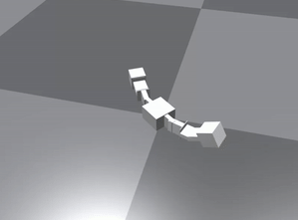
Experimental Setup: Environment
Revolve2
Provides a framework for robot shapes initialization
Interfaces different simulators
The simulator used in this project is OpenAI MuJoCo
Notes:
Policy Gradients with Parameter-based Exploration

Slide 22
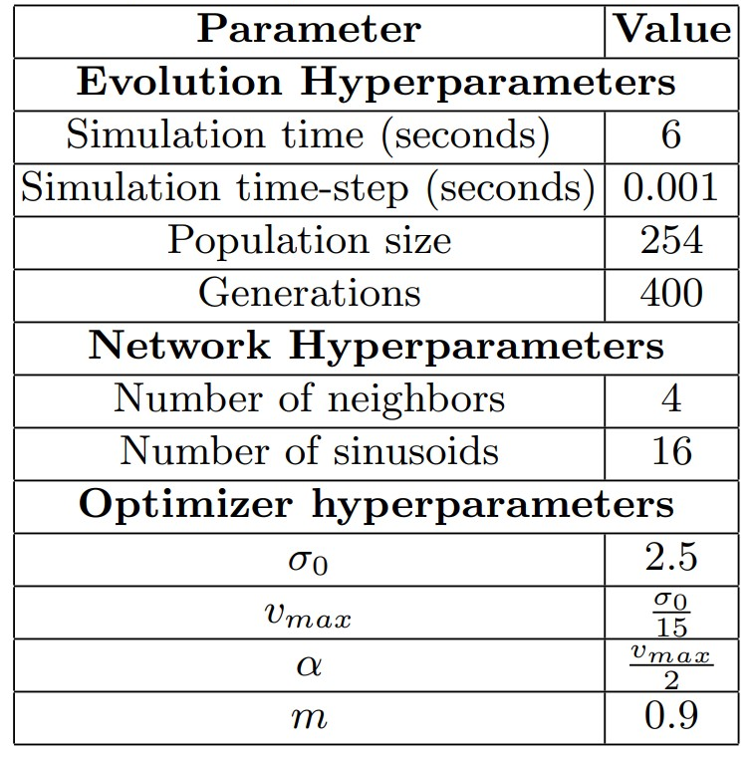
Experimental Setup: Parameters
Notes:
Policy Gradients with Parameter-based Exploration

Slide 23
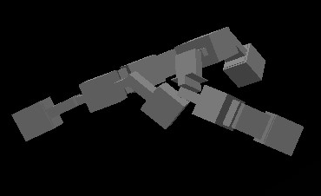
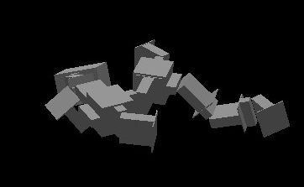
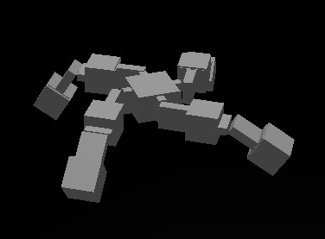
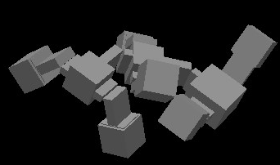
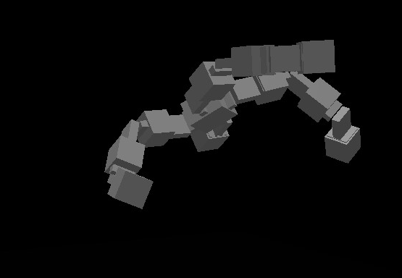
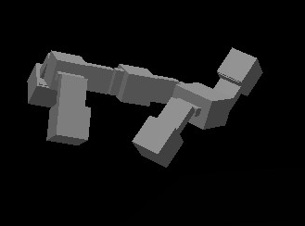
Experimental Setup: Body Shapes
4 bodies used during optimization
2 bodies solely used for testing
Babya
Insect
Spider
Ant
Babyb
Gecko
Notes:
Policy Gradients with Parameter-based Exploration

Slide 24
Experimental Setup: Evaluation Methods
Find point of fitness convergence
Fitness comparison across bodies for generalization
Ablations
SCN-0: Same topology, no neighbors
MLP-4: FeedForward Network 1 hidden layer with 16 nodes
Notes:
Policy Gradients with Parameter-based Exploration

Slide 25
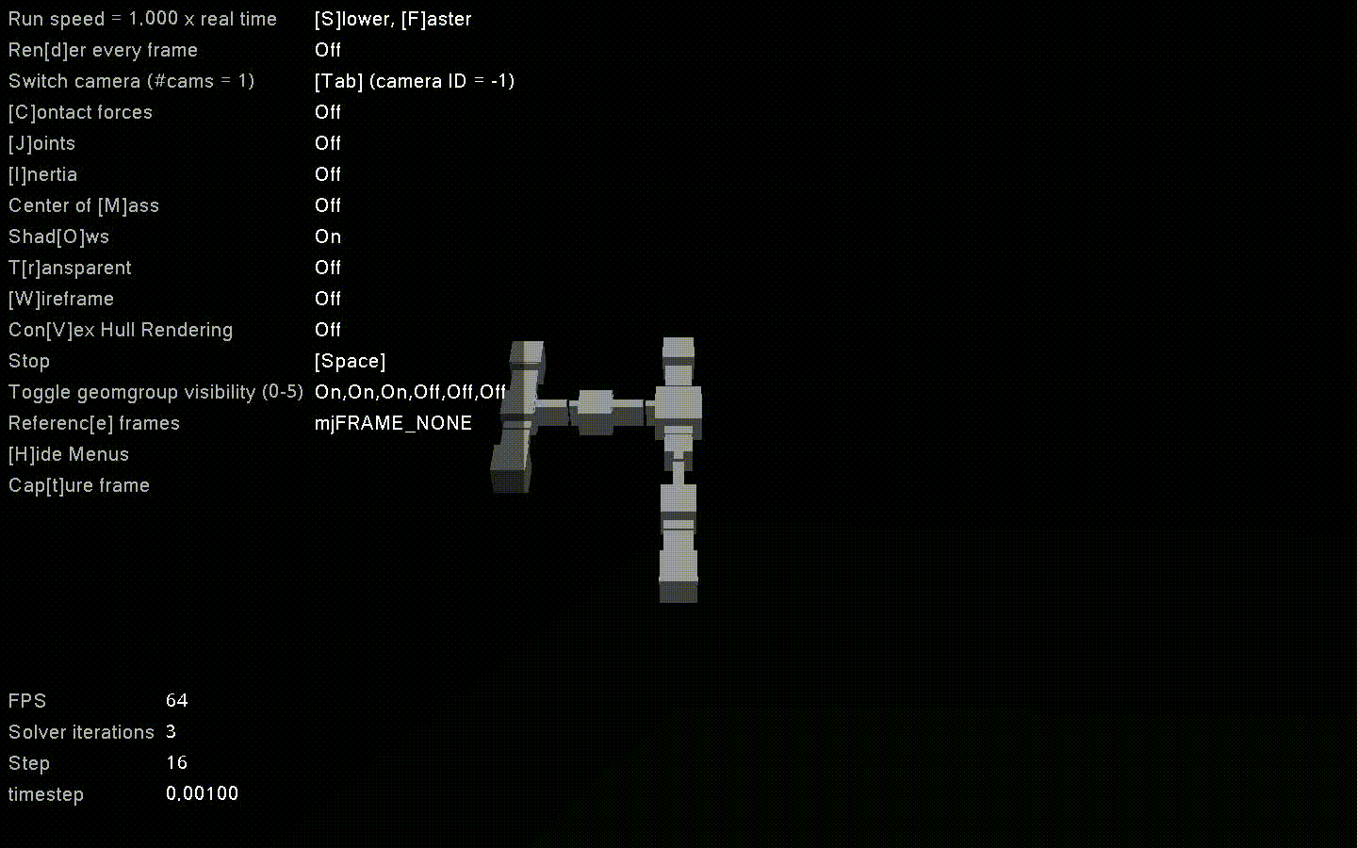
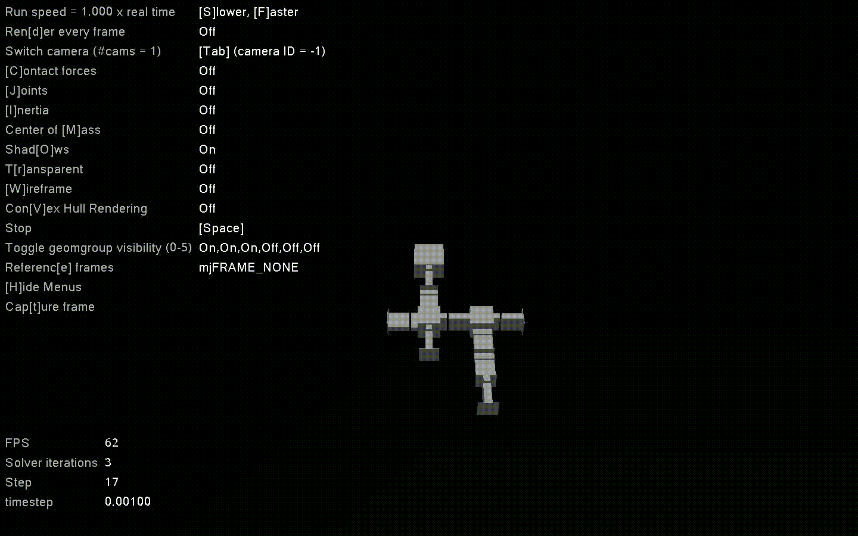
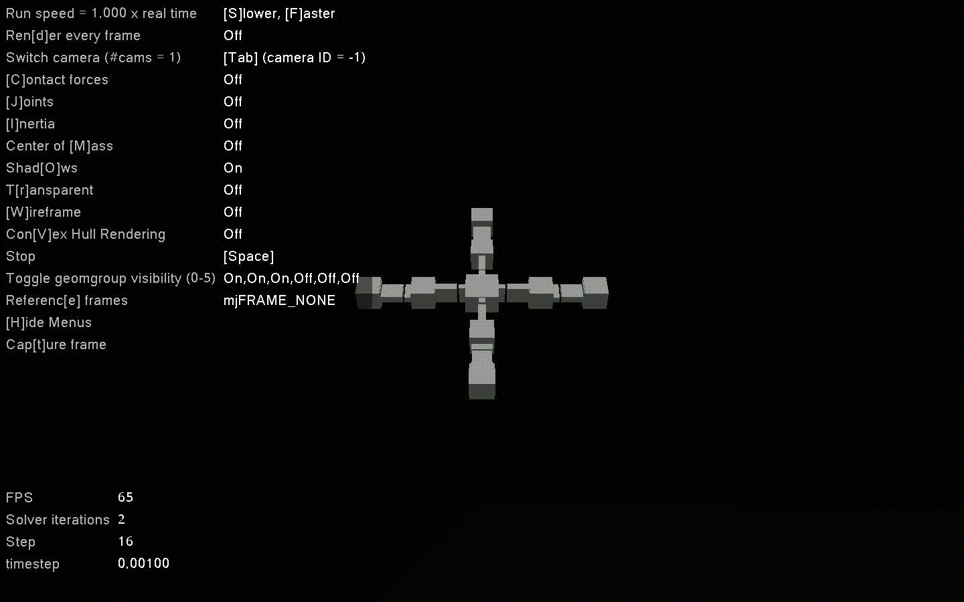
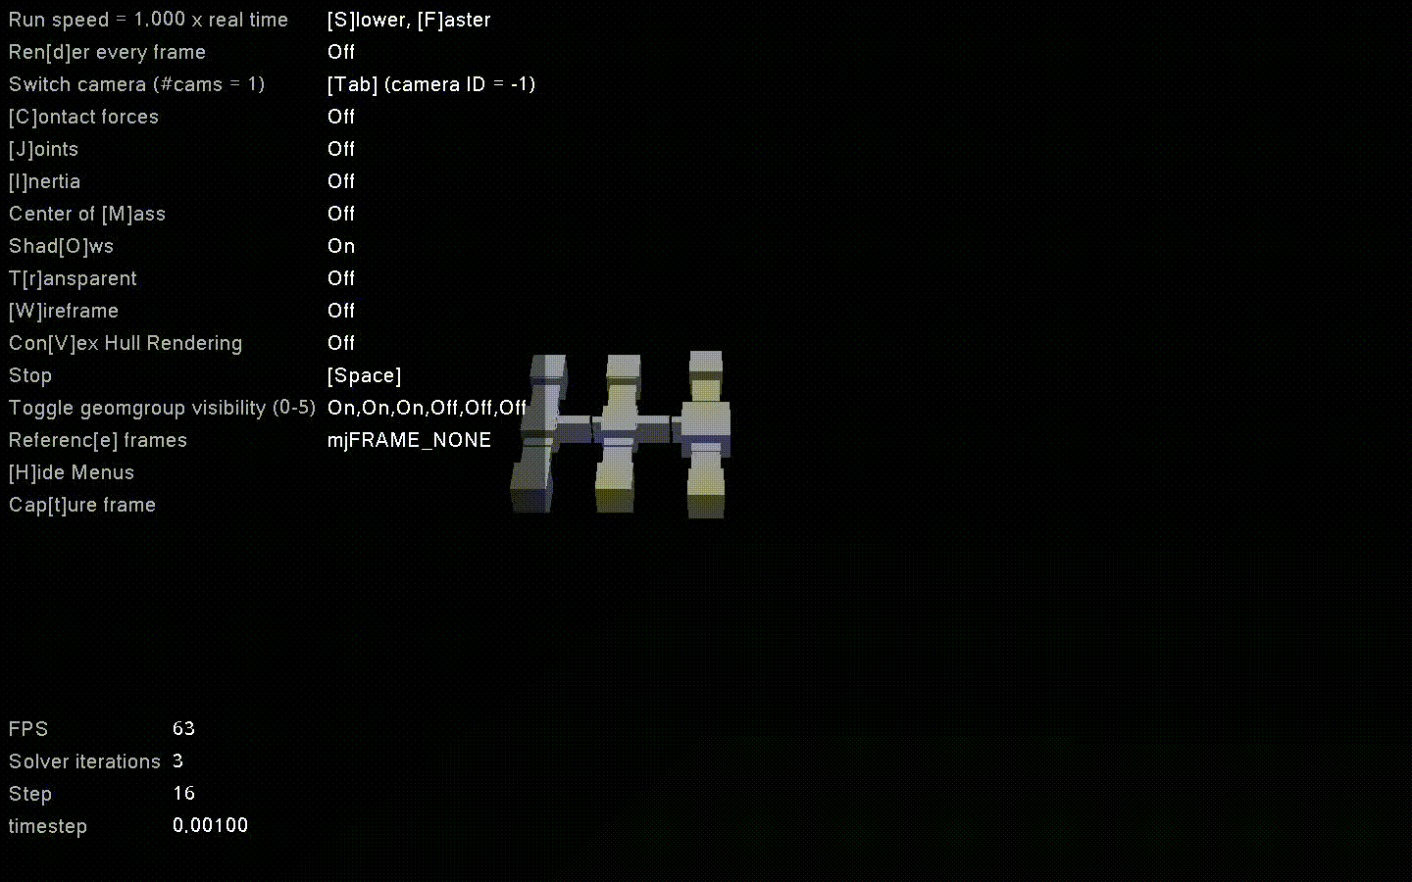
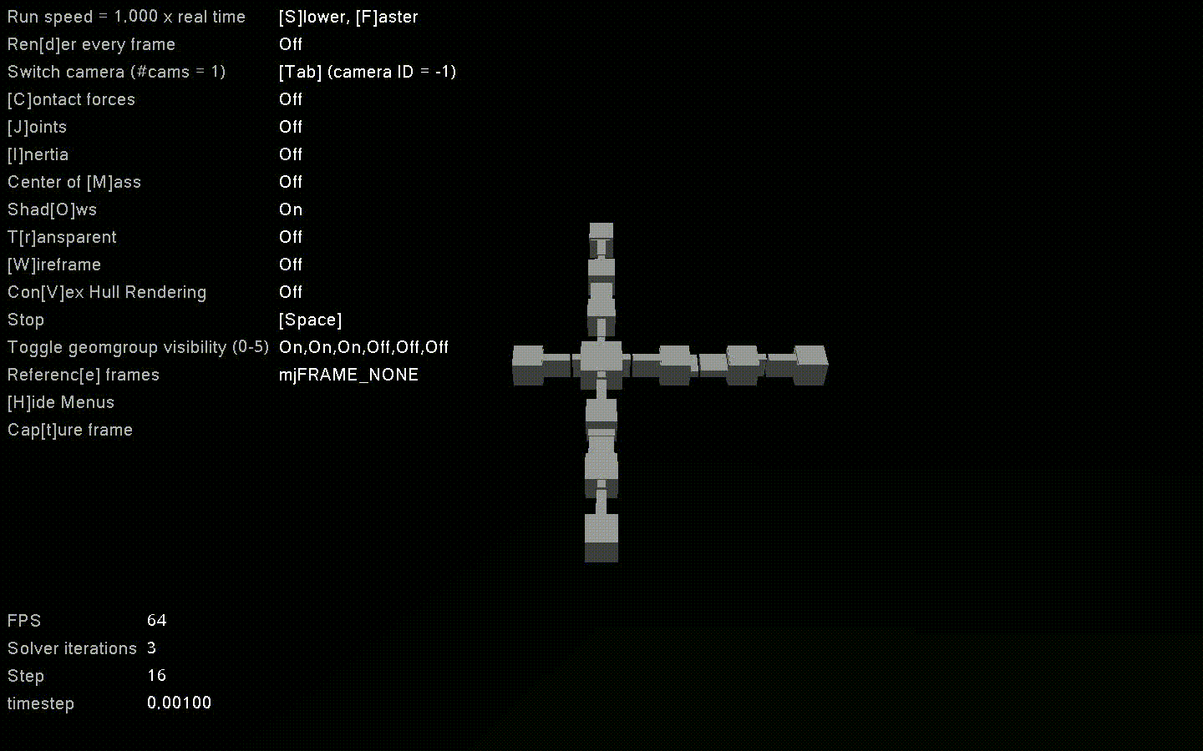
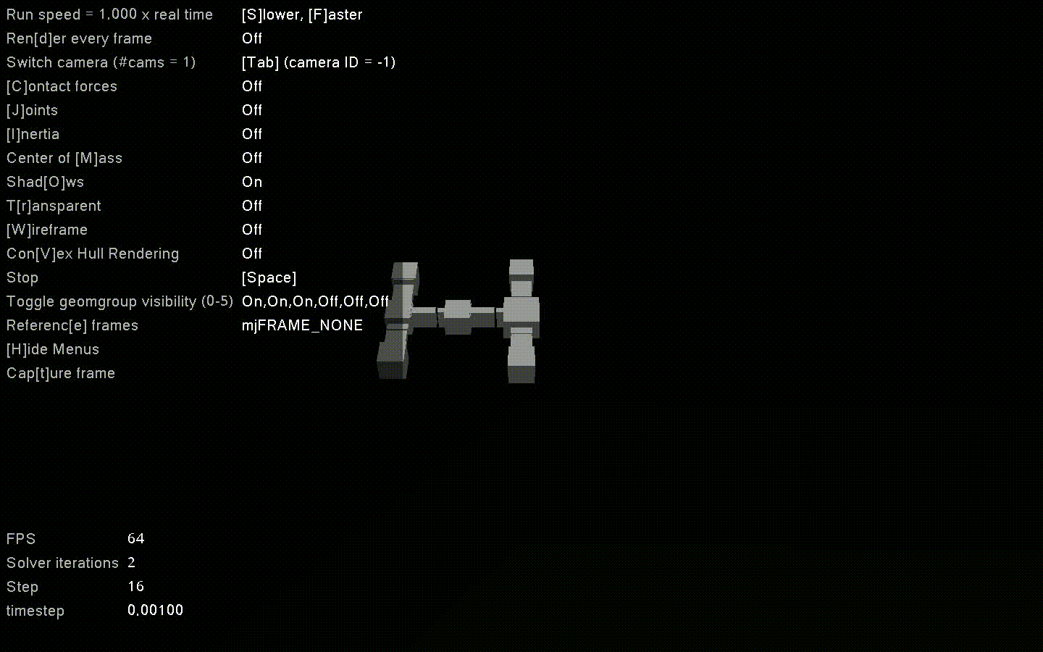
Results

Slide 26
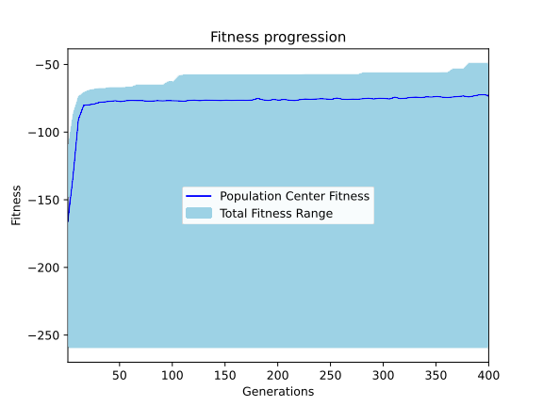
Results: Convergence
Convergence happens after slightly more than 100 generations
Notes:
Policy Gradients with Parameter-based Exploration

Slide 27
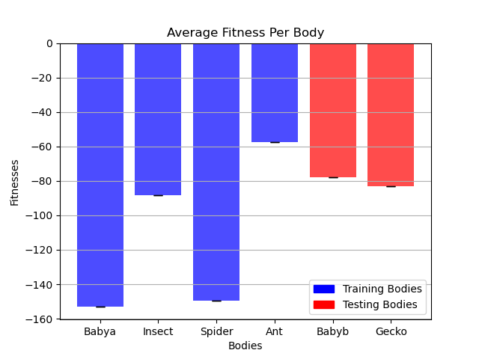
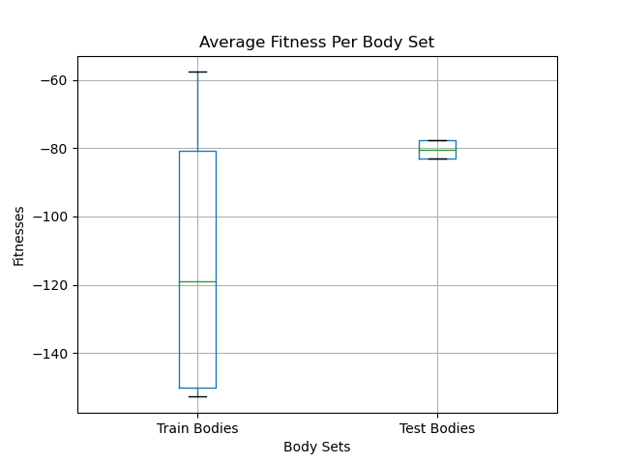
Results: Generalization
Not all bodies performed well, but the model generalizes to unseen bodies
Notes:
Policy Gradients with Parameter-based Exploration

Slide 28
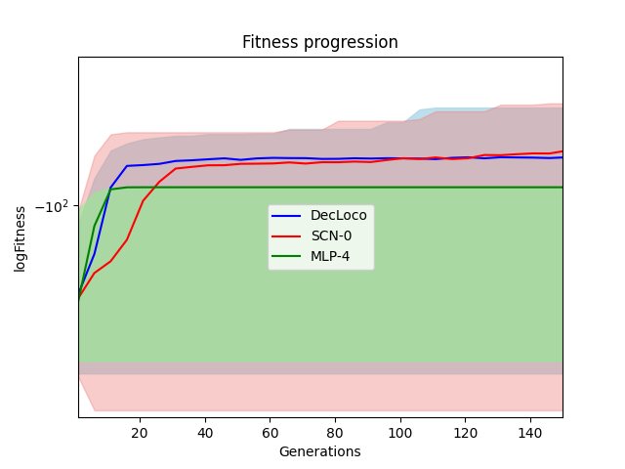
Results: Ablations
The topology is necessary, the neighbors are not
Notes:
Policy Gradients with Parameter-based Exploration

Slide 29
Conclusions

Slide 30
Conclusion
Although the model did not perform extremely well, it generalized across unseen bodies
CPG-inspired methods are still relevant when decentralized
Further research can focus on performance
Neighbors’ state is not useful, but global body state might be
E.G. number of joints, body’s center of mass, full body weight
Further research could include more diverse body types
E.G. wheeled, biped
Other techniques and architectures can be studied as well
E.G. numerical integration and Recurrent Neural Networks

Slide 31
Thank You.
References
Haarnoja, T., Ha, S., Zhou, A., Tan, J., Tucker, G., Levine, S.: Learning to walk via deep reinforcement learning. arXiv preprint arXiv:1812.11103 (2018)
Dzeladini, F., Ait-Bouziad, N., Ijspeert, A.: Cpg-based control of humanoid robot locomotion. Humanoid Robotics: A Reference pp. 1–35 (2018)
Sehnke, F., Osendorfer, C., R ̈uckstieß, T., Graves, A., Peters, J., Schmidhuber, J.: Parameter-exploring policy gradients. Neural Networks 23(4), 551–559 (2010)
Srouji, M., Zhang, J., Salakhutdinov, R.: Structured control nets for deep reinforcement learning. In: International Conference on Machine Learning. Pp. 4742–4751. PMLR (2018)
Notes:
Policy Gradients with Parameter-based Exploration

